Slide 1
Stacked Credentials
Transferability and
Guided Pathways
Module 5
Notes:
[Add opening background music]

Slide 2
Overview
Lesson 1: Stacked Credentials
Lesson 2: Transferability
Lesson 3: Guided Pathways
Notes:
Slide 2: Overview
In this module, we will talk about the importance of understanding how credentials stack, how workforce courses may or may not transfer, and how to guide students to select the right options for their education through guided pathways. [click]

Slide 3



Introduction
Plays an important role in supporting economic growth
Prepares students to transfer
Offers workforce programs geared towards the needs of the community
Notes:
Slide 3: Introduction
Community colleges play an important role in supporting regional economic growth. [click]
They prepare students to transfer into four-year degree programs by offering cost-effective education. [click]
They also offers workforce programs, which help the members of the community get employment ready. [click]

Slide 4



Critical Role
Create seamless and student-centric pathways
Encourages enrollment and persistence
Prioritizes quality in higher education
Notes:
Slide 4: Critical Role
Despite this critical role, community colleges and technical schools still have a lot of work to do in order to create seamless and student-centric pathways that encourage enrollment and persistence. [click]
Just like with all other current higher education programs, CTE/Workforce programs must ensure the delivery of high-quality student experiences and education. [click]

Slide 5


Lesson 1:
Stacked Credentials
Part of a sequence collected over time
Notes:
Slide 5: Lesson 1 Stacked Credentials
[Quick background music to introduce the first lesson]
What are stacked credentials and why is it important? [click]
According to the Department of Labor, stackable credentials are part of a sequence accumulated over time [click] to build up a qualification in order to move up a career ladder to potentially have a higher paying job or a promotion. [click]

Slide 6

Work of Counselors/Advisors
Understand how it works
Advise students & guide them in their options
Notes:
Slide 6: Work of Counselors/Advisors
It is important for counselors and advisors to understand how it works to advise prospective students and guide them in their options. [click]

Slide 7

Benefits
Career pathways for students
Less time & money
Special skills - aligned with employer
Notes:
Slide 7: Benefits
So, what are the benefits of stackable credentials? [click]
First, it provides career progressive pathways for students. Second, it requires less time and money than traditional credentials. Lastly, stackable credentials are aligned specifically with employer needs and therefore make students career ready. [click]

Slide 8
How To Achieve Stacked Credentials?
Progressive Stack
Level 1 Certificate
Level 2 Certificate
Associate Degree
Notes:
Slide 8: How to Achieve Stack Credentials?
How do you achieve stack credentials? [click]
One example of stacking is called Progressive Stack. This type of credential stacking lets you start with a certificate, for example Level 1 certification, which can lead to another certificate - Level 2 certificate, then to a subsequent degree such as associate degree, bachelor, master, and so forth. [click]
With this type of stacked credentials, the student can accumulate a series of building blocks that can pave a way to something bigger. [click]

Slide 9
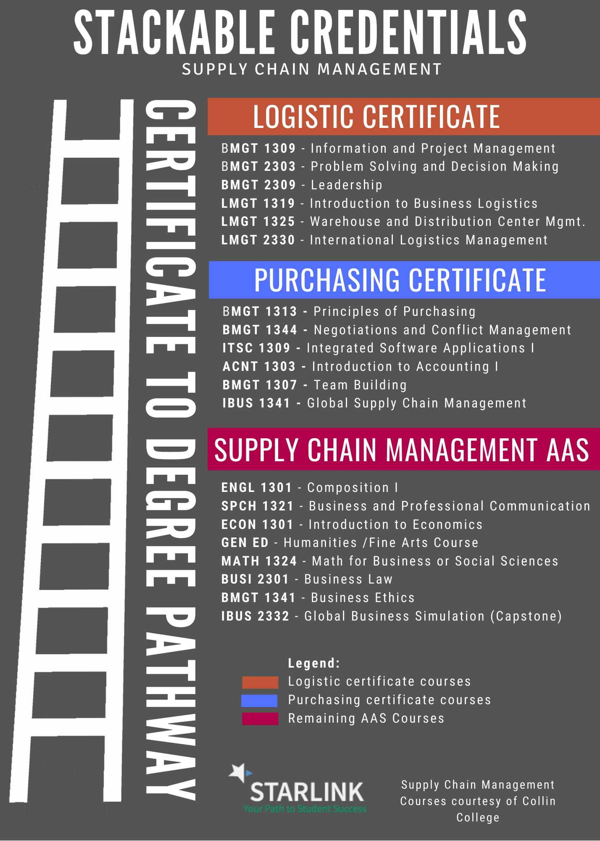

Stacked Credentials and Curriculum
Notes:
Slide 9: Stacked Credentials and Curriculum
For program or curriculum developers, knowing how to stack credentials when designing a program will benefit students tremendously. [Image of books stack should be displayed] [click]
Let’s look at a sample program with stacked credentials.
[Show example of Stacked Credentials using the infographic]
As you can see, all courses in both certificates are part of the associate degree. If the student decided to stop after acquiring one of the certificates, they can find a job specific to that certificate, then, later on, if they decided to come back, their current certificate will be applied to the associate degree. [click]
Optional: Open the Stackable Credentials in Google Slide to show a different version
On this version of the stackable credentials, it shows that all courses of the certificates are part of the AAS degree. [click]

Slide 10

Lesson 2:
Transferability
Notes:
Slide 10: Lesson 2 Transferability
[Quick intro music]
Now that we know more about stacked credentials and how they can help students, let’s take a look at our next topic, lesson 2, transferability. [click]

Slide 11


Statistics
Notes:
Slide 11: Statistics
According to the National Center for Education Statistics, many courses from community colleges either don’t transfer or do not apply when students enter a bachelor’s program and seek a 4-year degree. For some courses that do transfer, the issue becomes degree applicability. [click]

Slide 12

Tips - Selecting Program/Courses
Notes:
Slide 12: Tips - Selecting Program/Courses
To help the student make the most of their Community College credit, let’s take a look at some of the tips when making decisions to ensure courses are transferable. [click]

Slide 13

Tip 1 - Articulation Agreement
Ask community college for an articulation agreement
Notes:
Slide 13: Tip 1 - Articulation Agreement
Ask your community college for its articulation agreement. Some colleges have an articulation agreement with other schools including four-year universities and technical schools. An articulation will help guide and offers a road map of what will transfer among schools that are in the guide. Additionally, the Texas Core Curriculum has a provision that allows students (in Texas) to transfer the completed CORE courses they’ve taken to another public Texas higher institution. [click]
[Optional - We can add the paragraph of the provision as a screen capture]

Slide 14
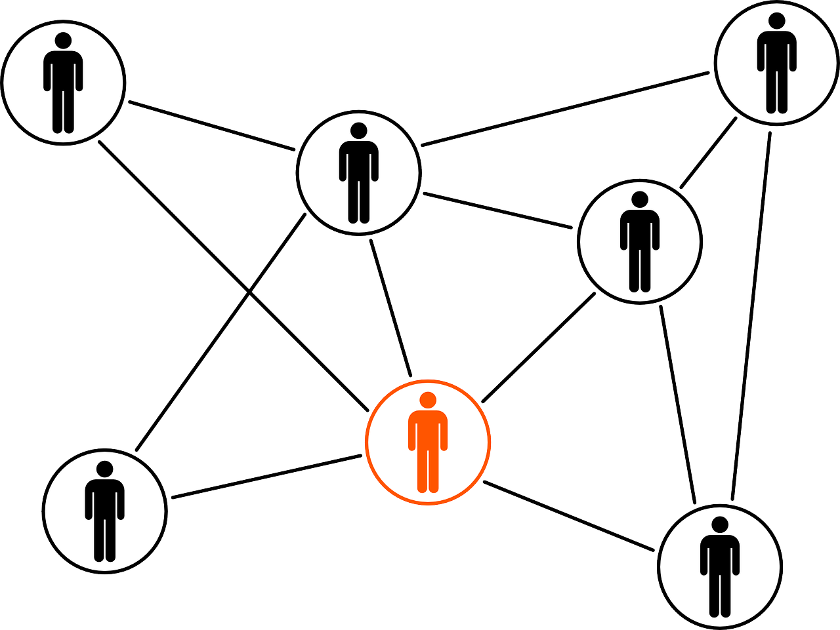
Tip 2 - Well-Connected Community
Select a well-connected community college
Notes:
Slide 14: Tip 2 - Well-connected community College
Select a well-connected community college. When selecting community college, focus on programs that have a relationship with other schools. Do they transfer credit? Do they have an articulation guide? It helps to speak with an admissions advisor and let them know you plan to transfer. [click]

Slide 15

Tip 3- Guaranteed Transfer
Select courses with Guaranteed Transfer
Notes:
Slide 15: Tip 3 - Guaranteed Transfer
Select courses with Guaranteed Transfer. Some colleges have partnerships with universities and will accept credits when the student transfer. Knowing in advance that the courses and programs will transfer gives students the flexibility in choosing cost-effective and convenient options. Verify from an advisor if your college has a partnership with the university you are interested. [click]

Slide 16

Tip 4 - Research
Do your research
Notes:
Slide 16: Tip 4 – Research
Do your research. It is always a good idea to do your research. Occasionally, you will come across programs that appear to be tailored to your needs. Keep a careful watch. Some schools are using application tools or roadmap to help the student plan the courses they need to take for their specific degree. [click]

Slide 17

Lesson 3:
Guided Pathways
Notes:
Slide 17: Lesson 3: GUIDED PATHWAYS
[Quick music intro]
In this lesson, you will learn how to guide students to select the right options for their education through the use of guided pathways. For students, finding a resource to help them find the perfect career and where to start is a tremendous help. [click]

Slide 18

What is a
Guided Pathway?
Notes:
Slide 18: What is a Guided Pathway?
But first, let’s find out what is a Guided Pathway. [click]
Guided pathways help students complete the program faster. The idea is that college students will complete the program in a timely manner if they choose and develop an academic plan early or at least have a clear road map of the courses they need to complete for credit. The guided pathways approach presents courses in highly structured and logical program maps. [click]

Slide 19

Benefits for Students
Notes:
Slide 19: Benefits for Students
So, what are some of the benefits of Guided Pathways? [click]
Let’s begin by looking at some of the benefits for the students (paused briefly to give time to read the text on the screen)
Using an academic pathway with the right schedule, students don’t have to discover the right path. It is already provided to them. [click]

Slide 20

Benefits
No permission needed
Notes:
Slide 20: 1. Benefits
With guided pathways, there are no blocks to register for a course, such as TSI-met, pre-requisites, and co-requisites, as long as the course is on the schedule. [click]

Slide 21

2. Benefits
Help earn college credential and career
Notes:
Slide 21: 2. Benefits
Additionally, a guided pathway will help you earn a college credential and build a career. [click]

Slide 22

Benefits for Advisors
Notes:
Slide 22: Benefits for Advisors
Now that we have an idea of the benefits for the student, let’s look at the takeaways for advisors. [click]

Slide 23

1. Advisor Benefit
Advising student will be easier
Notes:
Slide 23: Advisor Benefit
One of the major benefits is that it makes it easier to advise students. It will provide a defined career path, with simple, clear program maps and milestones. [click]

Slide 24

2. Advisor Benefits
Program maps will outline students options
Notes:
Slide 24: Benefits for Advisors
Finally, the guided pathways will help the student take the required courses because it outlines the student’s options. [click]
Optional: After mentioning Guided Pathways, show a sample of a pathways from NTCCC.

Slide 25
Credits
Notes:
Slide 25: Credits
[Closing background music]
Optional: Closing slide - with credits, resources, and references
References and Image Credit
5 Things you should know about stackable credentials
Making Credentials Matters
Accelerate TX
Building Texas by Offering Stackable Credentials
Do Community College Credits Transfer to a Four-Year Degree
What Do We Know About Guided Pathways
Texas Core Curriculum - April 2018
All images came from Pixabay.com with no attribution required and they are free for commercial use.

